Slide 1

Clustering Analysis of Utility Energy Consumption by ZIP Code
Student: Jimmy Ma U55133201
Date: February 24th ,2025
CS 777 final Project

Slide 2
Agenda
Introduction
Data Overview & Preprocessing
Methodology & Implementation
Results: K-Means & GMM
Comparative Analysis & Discussion
Conclusion

Slide 3
Introduction
Goal: Identify natural groups among ZIP codes using energy usage data.
Dataset : Utility Energy Registry Monthly ZIP Code Energy Use: 2016-2021
Objectives :
Identify clusters corresponding to low, moderate, high, and very-high consumption.
Compare K-Means and Gaussian Mixture Model (GMM) methods.
Explore potential factors (e.g., urban density, industrial activity, seasonality).

Slide 4
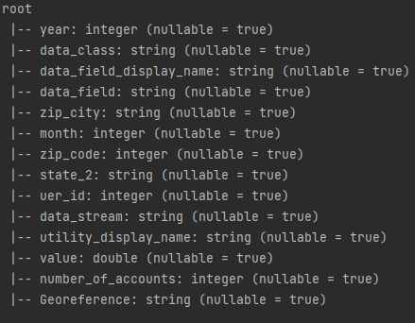
Data Overview & Preprocessing
Data Source:
Utility Energy Registry Monthly ZIP Code Energy Use: 2016-2021 | State of New York
Data Schema:
Preprocessing Steps:
Data cleaning (removing missing zip_code or value rows)
Casting value as double
Feature engineering using PySpark’s VectorAssembler
Train-test split (70/30)

Slide 5
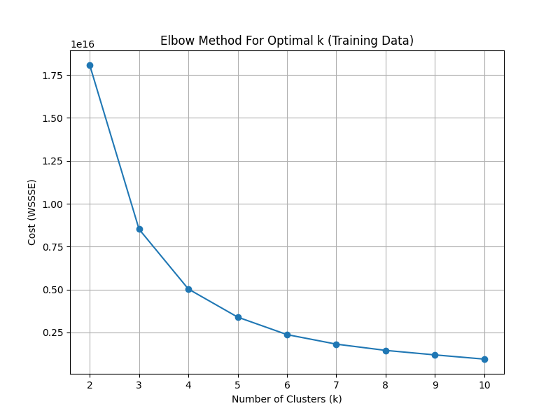
Methodology & Implementation
Clustering Algorithms: K-Means and GMM
Optimal k (Elbow Method, silhouette scores)
Tools: PySpark, Matplotlib, Seaborn, and Folium for geospatial mapping

Slide 6
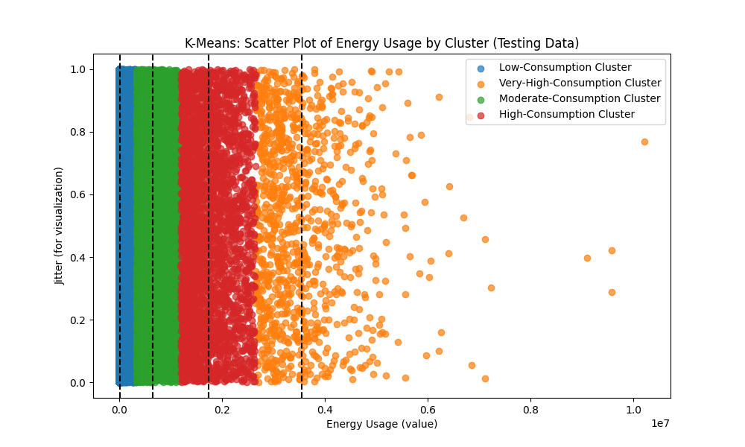
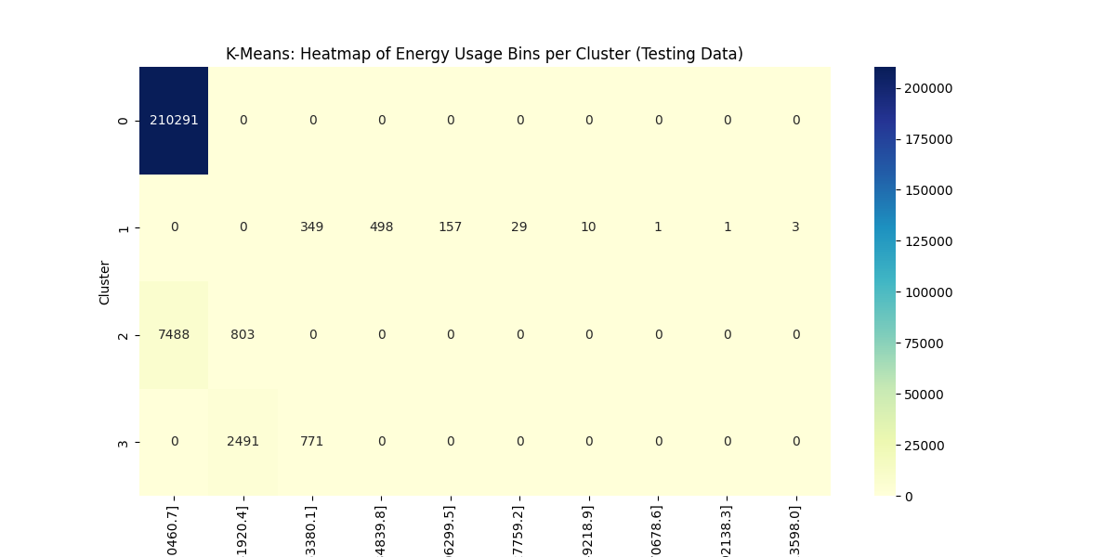
K-Means Clustering
Elbow plot demonstrating k = 4
Cluster centers: [10,941] , [651,135] ,[1,731,198] and [3,554,447].
Silhouette score: 0.9661
Raw cluster centers and labels (Low, Moderate, High, Very-High)
Visualizations: Scatter plot, heatmap, and geospatial map

Slide 7
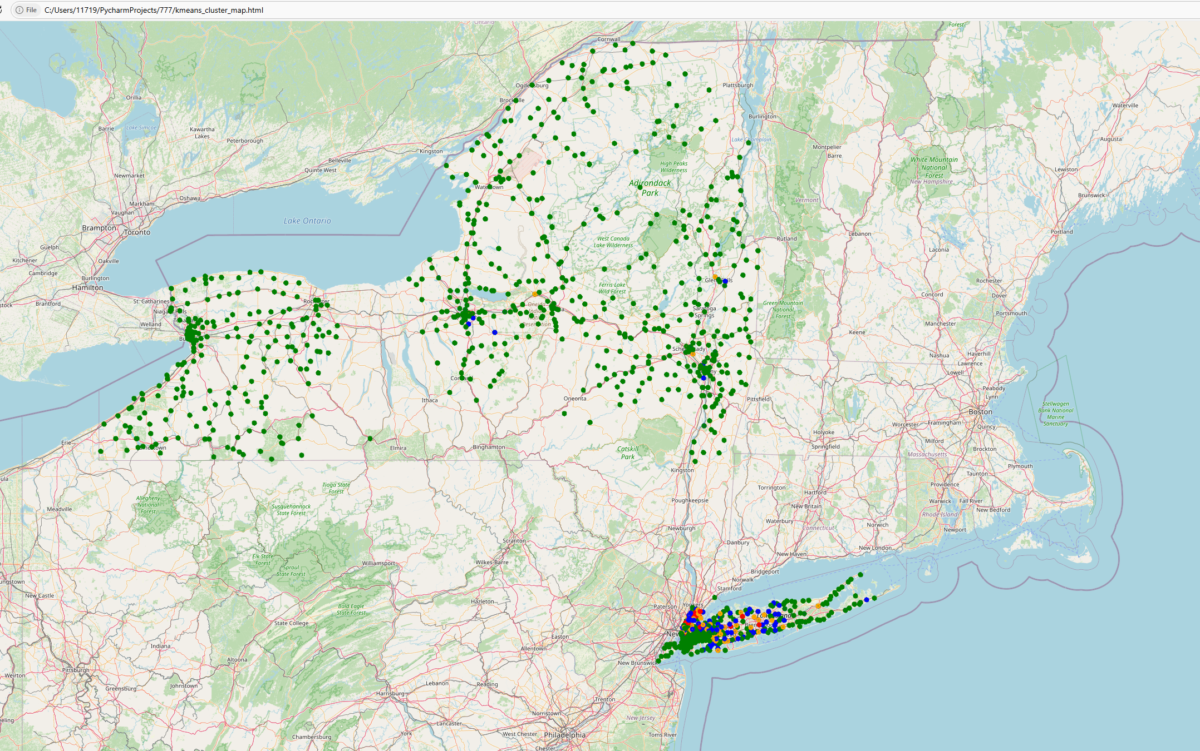
K-Means geospatial map
low consumption area: upstate areas
high consumption area: urban regions such as NYC

Slide 8
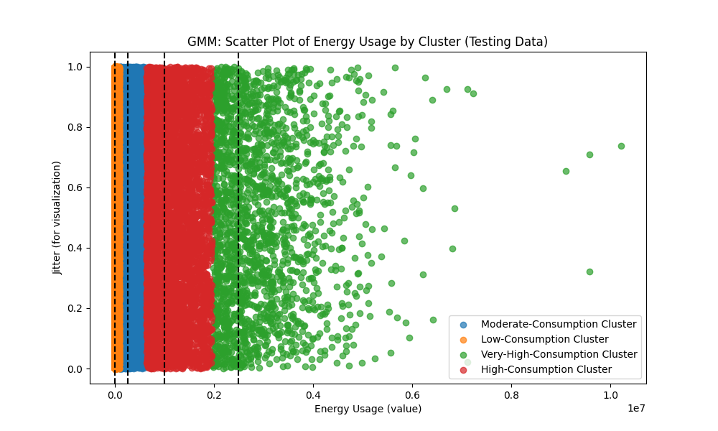
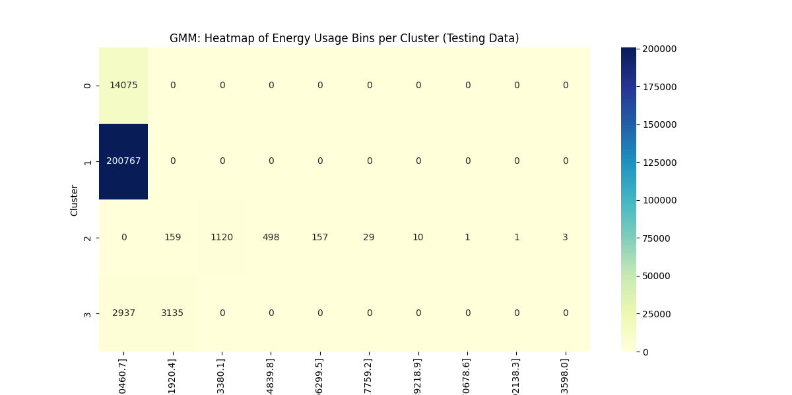
GMM Clustering
Cluster centers: [2,840] , [256,325] ,[1,001,462] and [2,488,825].
Silhouette score: 0.9265
Raw cluster means and labels
Visualizations: Scatter plot, heatmap, and geospatial map

Slide 9
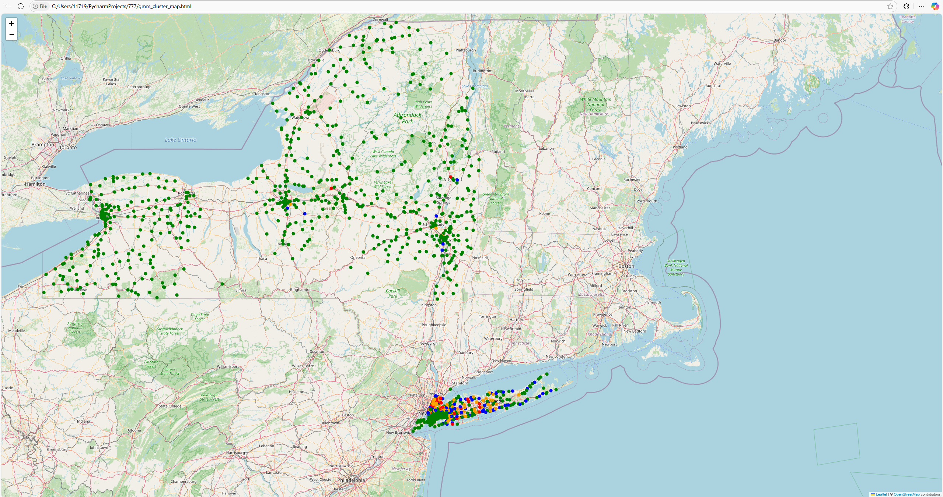
GMM geospatial map
The interactive Folium map highlights similar regional patterns as K-Means
This confirm the segmentation across New York.

Slide 10

Comparative Analysis
K-Means:
Hard assignments with spherical clusters.
High silhouette score (0.9661) and crisp boundaries.
GMM:
Soft, probabilistic assignments with elliptical clusters.
Slightly lower silhouette score (0.9265) but captures uncertainty in overlapping areas.
Implications:
Both models reliably identify four distinct consumption segments, and the geospatial maps reinforce these findings by showing that high-consumption areas are predominantly in urban regions.

Slide 11

Conclusion
• Clustering reveals meaningful segments.
• The results offer actionable insights for targeted energy efficiency programs and infrastructure investments.
• Future work will focus on integrating additional features and extending the analysis temporally.

Slide 12
Thank you
Jimmy Ma
617-555-0152
m1171916379@gmail.com

